Slide 1
Data Science and Python
Unit 2

Slide 2
What is Data Science
Data science – getting insight from data
Data Science is a blend of various tools, algorithms, and machine learning principles with the goal to discover hidden patterns from the raw data.
This aspect of data science is all about uncovering findings from data. Diving in at a granular level to mine and understand complex behaviors, trends, and inferences. It's about surfacing hidden insight that can help enable companies to make smarter business decisions.
“Data science is the discipline of making data useful.”

Slide 3
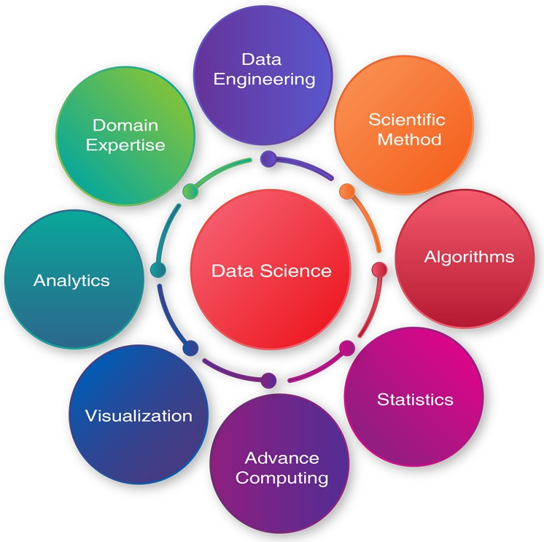

Slide 4



Data All Around
Lots of data is being collected and warehoused
  Web data, e-commerce
  Financial transactions, bank/credit transactions
  Online trading and purchasing
  Social Network

Slide 5
Types of Data We Have
Relational Data (Tables/Transaction/Legacy Data)
Text Data (Web)
Semi-structured Data (XML)
Graph Data
Social Network, Semantic Web (RDF), …
Streaming Data

Slide 6
Big Data and Data Science
Over the last decade there’s been a massive explosion in both the data generated and retained by companies. Sometimes we call this “big data,” we’d like to build something with it.
Data scientists are the people who make sense out of all this data and figure out just what can be done with it.
Data Scientist is the“sexiest job title of the 21st century.

Slide 7
Data Science---Multidisciplinary field
Data science is an extension of various data analysis fields such as data mining, statistics, predictive analysis and many more.
Data Science is a huge field that uses a lot of methods and concepts which belongs to other fields like information science, statistics, mathematics, and computer science.
Some of the techniques utilized in Data Science encompasses machine learning, visualization, pattern recognition, probability model, data engineering, signal processing, etc.

Slide 8
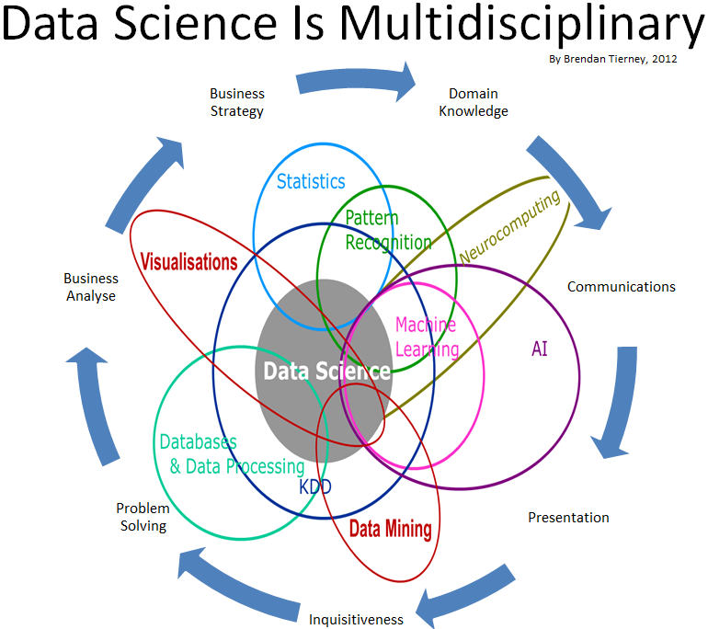

Slide 9
What do Data Scientists do?
Data scientists are the key to realizing the opportunities presented by big data.
They bring structure to it, find compelling patterns in it, and advise executives on the implications for products, processes, and decisions
Some of them are:
  Internet Search
  Digital Advertisements
  Recommender Systems like Amazon, Netflix
  Image Recognition e.g. tag your friends
  Speech Recognition e.g. google Voice, Siri, Cortana etc.
  Healthcare eg. Disease prediction
  Airline Route Planning
  Fraud and Risk Detection
  Delivery logistics e.g. DHL, FedEx

Slide 10
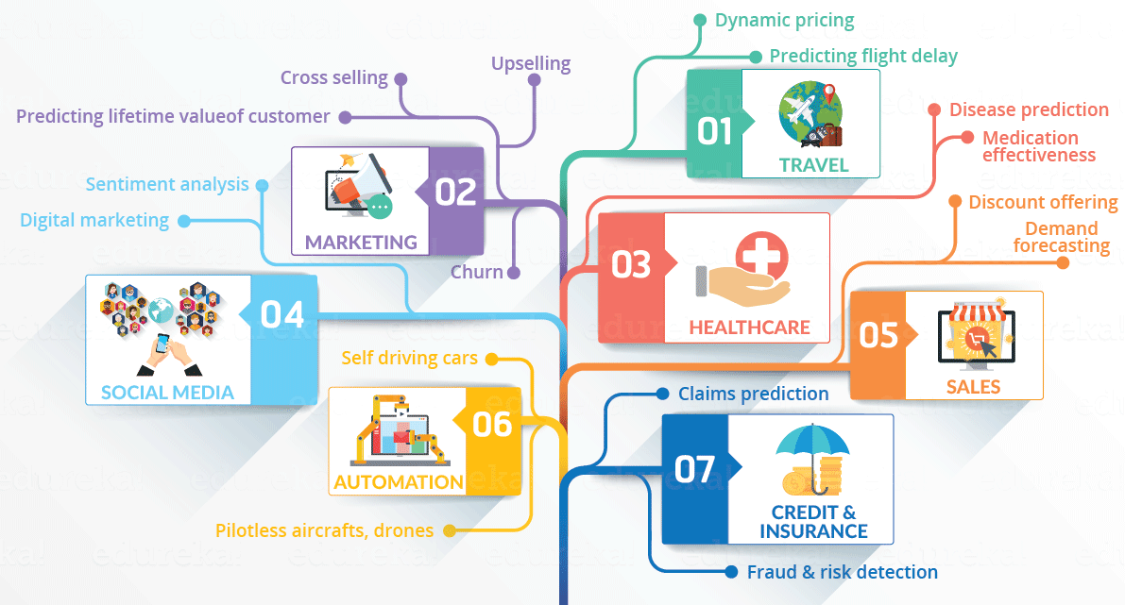

Slide 11
Choosing a data science language
Choosing the correct tool makes your life easier.
Data scientists usually use only a few languages because they make working with data easier.
With this in mind, here are the four top languages for data science work in order of preference (used by 91 percent of the data scientists out there):
  Python
  R
  SAS
  SQL

Slide 12
Outlining the core competencies of a data scientist
data scientist requires knowledge of a broad range of skills in order to perform the required tasks. In fact, so many different skills are required that data scientists often work in teams.
Someone who is good at gathering data might team up with an analyst and someone gifted in presenting information.
It would be hard to find a single person with all the required skills.
following list describes areas in which a data scientist could excel
  Data capture
  Analysis
  Presentation

Slide 13
Outlining the core competencies of a data scientist
Data capture:
  Capturing data begins by managing a data source using database management skills. However, raw data isn’t particularly useful in many situations— you must also understand the data domain. Finally, you must have data‐modeling skills so that you understand how the data is connected and whether the data is structured.
  Analysis:
    You perform some analysis using basic statistical tool skills, much like those that just about everyone learns in college. However, the use of specialized math tricks and algorithms can make patterns in the data more obvious or help you draw conclusions

Slide 14
Outlining the core competencies of a data scientist
Presentation:
  It’s important to provide a graphical presentation of these patterns to help others visualize what the numbers mean and how to apply them in a meaningful way. More important, the presentation must tell a specific story so that the impact of the data isn’t lost.

Slide 15
Understanding the role of programming
A data scientist may need to know several programming languages in order to achieve specific goals.
Manually performing these tasks is time consuming and error prone, so programming presents the best method for achieving the goal.
Given the number of products that most data scientists use, it may not be possible to use just one programming language.
Yes, Python can load data, transform it, analyze it, and even present it to the end user, but it works only when the language provides the required functionality.
The languages you choose depend on a number of criteria.
  How you intend to use data science in your code
  Your familiarity with the language
  The need to interact with other languages
  The availability of tools to enhance the development environment
  The availability of APIs and libraries to make performing tasks easier

Slide 16
Creating the Data Science Pipeline
Data science pipeline, which requires the data scientist to follow particular steps in the preparation, analysis, and presentation of the data.
Preparing the data- The data that you access from various sources doesn’t come in an easily packaged form, ready for analysis. you may also need to transform it to make all the data sources cohesive and amenable to analysis. Transformation may require changing data types, the order in which data appears, and even the creation of data entries based on the information provided by existing entries.
Performing exploratory data analysis-data science provides access to a wealth of statistical methods and algorithms that help you discover patterns in the data. A single approach doesn’t ordinarily do the trick. You typically use an iterative process to rework the data from a number of perspectives.

Slide 17
Creating the Data Science Pipeline
Learning from data-As you iterate through various statistical analysis methods and apply algorithms to detect patterns, you begin learning from the data. . In fact, it’s the fun part of data science because you can’t ever know in advance precisely what the data will reveal to you. Of course, the imprecise nature of data and the finding of seemingly random patterns in it means keeping an open mind.
Visualizing-Visualization means seeing the patterns in the data and then being able to react to those patterns. It also means being able to see when data is not part of the pattern. Think of yourself as a data sculptor — removing the data that lies outside the patterns (the outliers) so that others can see the masterpiece of information beneath.
Obtaining insights and data products-The insights you obtain from manipulating and analyzing the data help you to perform real‐world tasks. For example, you can use the results of an analysis to make a business decision.

Slide 18
Understanding Python’s Role in Data Science
Many different ways are available for accomplishing data science tasks.
Python represents one of the few single‐stop solutions that you can use to solve complex data science problems.
Instead of having to use a number of tools to perform a task, you can simply use a single language, Python, to get the job done.
The Python difference is the large number scientific and math libraries created for it by third parties. Plugging in these libraries greatly extends Python and allows it to easily perform tasks that other languages could perform, but with great difficulty.
Python is that it supports four different coding styles:
  Functional
  Procedural
  Object Oriented
  imparative

Slide 19
Learning to Use Python Fast
As part of Data Science many things are required to be done. Python can be used to perform various task of data science pipeline like:
  Loading data
  Training model
  Visualizing data

Slide 20
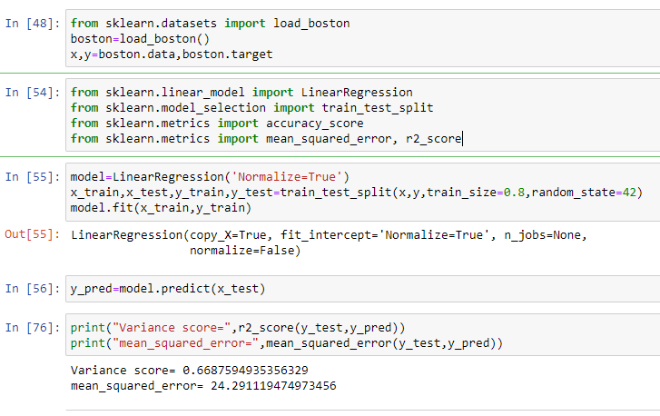

Slide 21
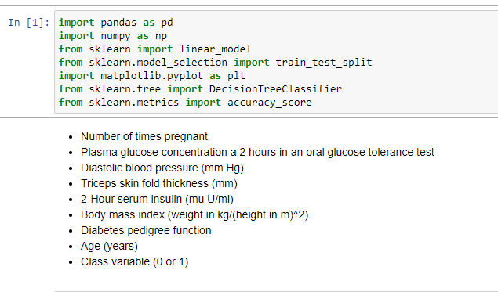

Slide 22
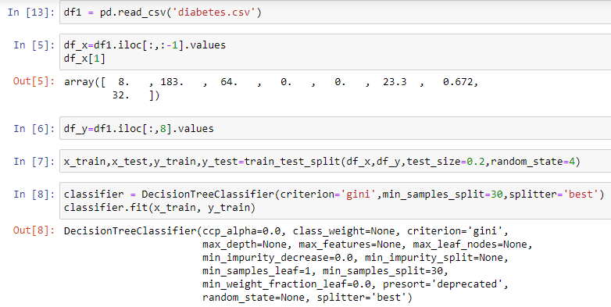

Slide 23
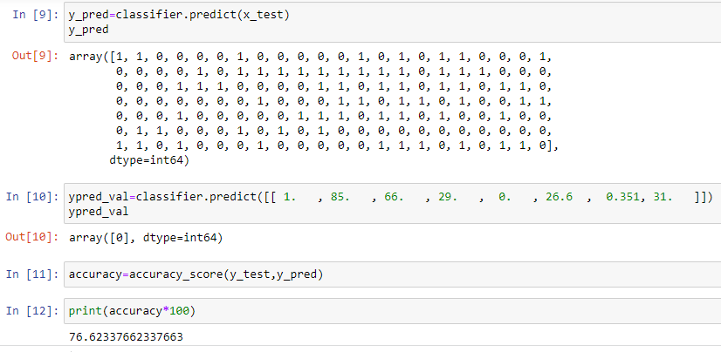

Slide 24
Performing Rapid Prototyping and Experimentation
Python is all about creating applications quickly and then experimenting with them to see how things work.
The act of creating an application design in code without necessarily filling in all the details is prototyping and is faster in python.
Data science doesn’t rely on static solutions. You may have to try multiple solutions to find the particular solution that works best.
After you create a prototype, you use it to experiment with various algorithms to determine which algorithm works best in a particular situation.

Slide 25
Considering Speed of Execution
Following factors control the speed of execution for your data science application:
  Dataset size
  Loading technique
  Coding style
  Machine capability
  Analysis algorithm

Slide 26
Using the Python Ecosystem for Data Science
This section provides an overview of the libraries you use for the data science examples
Accessing scientific tools using SciPy
The SciPy stack (http://www.scipy.org/) contains a host of other libraries that you can also download separately. These libraries provide support for mathematics, science, and engineering.
These libraries are
  NumPy
  SciPy
  matplotlib
  IPython
  Sympy
  Pandas
  SciPy is a general‐purpose library that provides functionality for multiple problem domains. It also provides support for domain‐specific libraries, such as Scikit‐learn, Scikit‐image, and statsmodels.

Slide 27
Using the Python Ecosystem for Data Science
Performing fundamental scientific computing using NumPy
The NumPy library (http://www.numpy.org/) provides the means for performing n‐dimensional array manipulation. NumPy functions that include support for linear algebra, Fourier transform, and random‐number generation.
Performing data analysis using pandas
The pandas library (http://pandas.pydata.org/) provides support for data structures and data analysis tools. The basic principle behind pandas is to provide data analysis and modeling support for Python.

Slide 28
Using the Python Ecosystem for Data Science
Implementing machine learning using Scikit‐learn
The Scikit‐learn library (http://scikit‐learn.org/stable/) is one of a number of Scikit libraries that build on the capabilities provided by NumPy and SciPy to allow Python developers to perform domain‐specific tasks. It provides access to the following sorts of functionality:
  Classification
  Regression
  Clustering
  Dimensionality reduction
  Model selection
  Preprocessing

Slide 29
Using the Python Ecosystem for Data Science
Plotting the data using matplotlib
The matplotlib library (http://matplotlib.org/) provides you with a MATLAB‐like interface for creating data presentations of the analysis you perform.
The library is currently limited to 2D output, but it still provides you with the means to express graphically the data patterns you see in the data you analyze. Without this library, you couldn’t create output that people outside the data science community could easily understand.
Parsing HTML documents using Beautiful Soup
The Beautiful Soup library (http://www.crummy.com/software/ BeautifulSoup/) download is actually found at https://pypi.python. org/pypi/beautifulsoup4/4.3.2. This library provides the means for parsing HTML or XML data in a manner that Python understands. It allows you to work with tree‐based data.

Slide 30
Working at the command line or in the IDE
Anaconda is a product that makes using Python even easier. It comes with a number of utilities that help you work with Python in a variety of ways.
Anaconda is actually a compilation of several open source applications. You can use these applications individually or in cooperation with each other to achieve specific coding goals.
  Jupyter Notebook/IPython Notebook
  Spyder
  IPython QT Console
  Anaconda Command Prompt
    Python Interprepter
    Ipython Console

Slide 31
Creating new sessions with Anaconda Command Prompt
Only one of the Anaconda utilities provides direct access to the command line, Anaconda Command Prompt.
When you start this utility, you see a command prompt at which you can type commands.
Using Anaconda Command prompt you can start various utility through command:
  jupyter notebook
  spyder
  ipython to open IPython Console
  python to open python interpreter
  IPython qtconsole

Slide 32
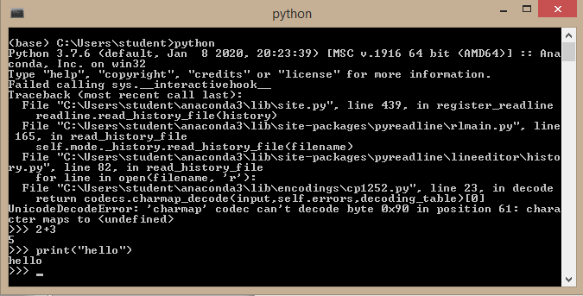
Python Interpreter

Slide 33
Python Interpreter
Python interpreter is in an interactive mode when it reads commands from a tty. The primary prompt is the following:
>>>
When it shows this prompt, it means it prompts the developer for the next command. This is the REPL. Before it prints the first prompt, Python interpreter prints a welcome message that also states its version number and a copyright notice.
This is the secondary prompt:
…
This prompt denotes continuation lines.
You quit the interpreter by typing quit() and pressing Enter.

Slide 34
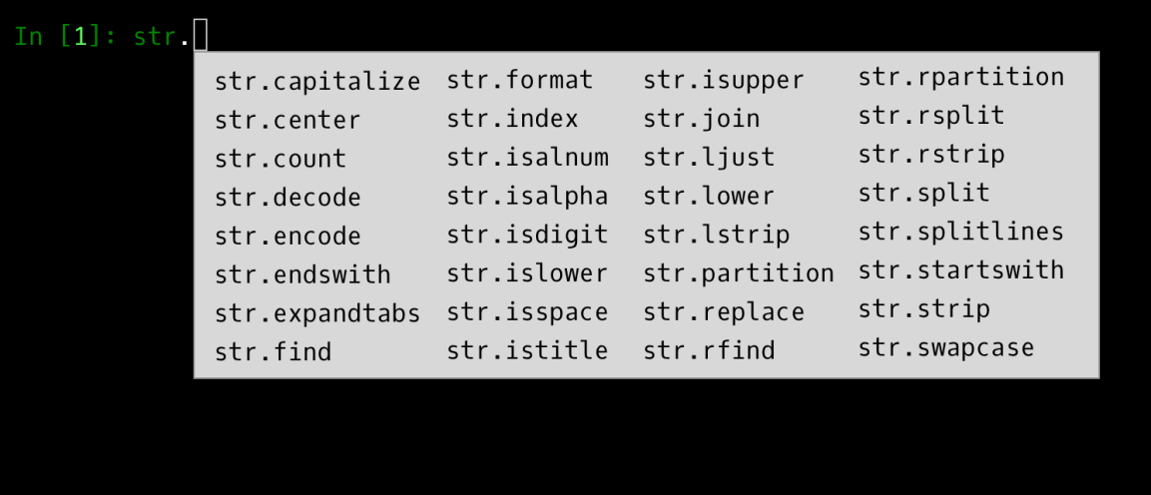
Entering the IPython environment
The Interactive Python (IPython) environment provides enhancements to the standard Python interpreter.
  Run Native Shell Commands
  Syntax Highlighting
  Proper Indentation
  Tab Completion
  Documentation like str.capitalize?

Slide 35
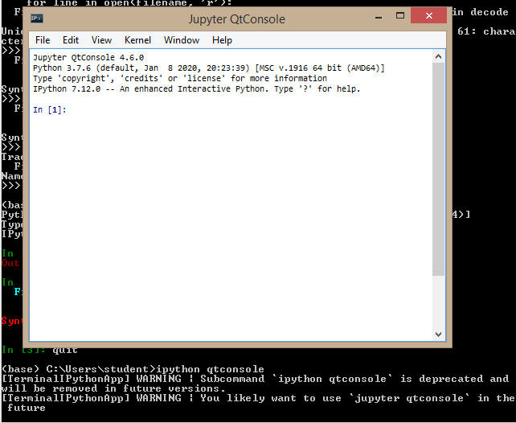
Entering IPython QTConsole environment
It adds a GUI on top of IPython that makes using the enhancements that IPython provides a lot easier,

Slide 36
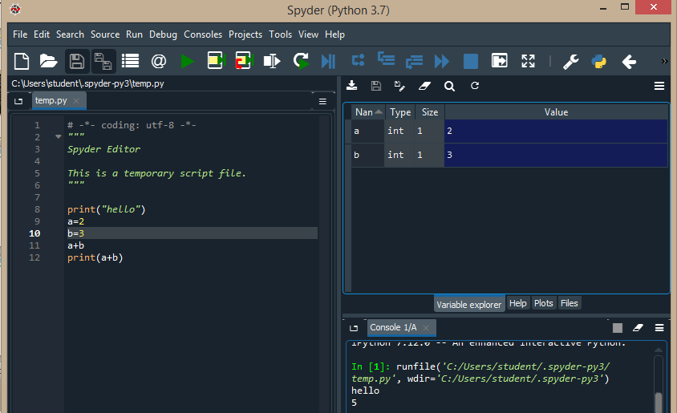
Editing scripts using Spyder
Spyder is a fully functional Integrated Development Environment (IDE). You use it to load scripts, edit them, run them, and perform debugging tasks.

